Slide 1
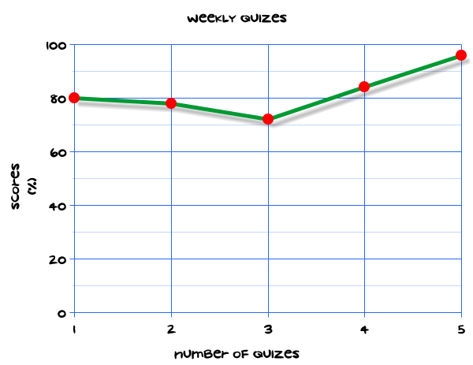
My Statistics Interactive Notebook
Name
Class
Teacher
Term 1 Semester 1
1

Slide 2
Create your own front page
It needs to contain the following –
My number interactive notebook
Name
Class
Teachers Name
Semester 1 Term 1
Page number 1

Slide 3
Contents
Glossary or Formula Page
Page
Date
Description
2
3

Slide 4
Tasks
24
7
30
Essential Question
Questions
Notes
Summary
4
5

Slide 5
24
7
30
Date
Title
EQ –
5

Slide 6
24
7
30
Date
Boxplots
EQ –
What are boxplots used to measure and how are they created?
5

Slide 7
24
7
30
Date
Boxplots
EQ –
What are boxplots used to measure and how are they created?
What are boxplots used for?
5

Slide 8
24
7
30
Date
Boxplots
EQ –
What are boxplots used to measure and how are they created?
What are boxplots used for?
The boxplot, also known as the box-and-whisker plot, is an exploratory graphic used to show the distribution of a dataset (at a glance).
5

Slide 9
24
7
30
Date
Boxplots
EQ –
What are boxplots used to measure and how are they created?
What are boxplots used for?
The boxplot, also known as the box-and-whisker plot, is an exploratory graphic used to show the distribution of a dataset (at a glance).
How do I create a boxplot?
5

Slide 10
24
7
30
Date
Boxplots
EQ –
What are boxplots used to measure and how are they created?
What are boxplots used for?
The boxplot, also known as the box-and-whisker plot, is an exploratory graphic used to show the distribution of a dataset (at a glance).
How do I create a boxplot?
Organise your data from least to greatest.
5

Slide 11
24
7
30
Date
Boxplots
EQ –
What are boxplots used to measure and how are they created?
What are boxplots used for?
The boxplot, also known as the box-and-whisker plot, is an exploratory graphic used to show the distribution of a dataset (at a glance).
How do I create a boxplot?
Organise your data from least to greatest.
Find the median, Q1 and Q3 of your data.
5

Slide 12
24
7
30
Date
Boxplots
EQ –
What are boxplots used to measure and how are they created?
What are boxplots used for?
The boxplot, also known as the box-and-whisker plot, is an exploratory graphic used to show the distribution of a dataset (at a glance).
How do I create a boxplot?
Organise your data from least to greatest.
Find the median, Q1 and Q3 of your data.
Draw a plot line. This should be long enough to contain all of your data, plus a little extra on either side. Make sure to place the numbers at even intervals. If you're dealing with decimals, such as 4.5 and 1.5, be sure to label them as well.
5

Slide 13
24
7
30
Date
Boxplots
EQ –
What are boxplots used to measure and how are they created?
What are boxplots used for?
The boxplot, also known as the box-and-whisker plot, is an exploratory graphic used to show the distribution of a dataset (at a glance).
How do I create a boxplot?
Organise your data from least to greatest.
Find the median, Q1 and Q3 of your data.
Draw a plot line. This should be long enough to contain all of your data, plus a little extra on either side. Make sure to place the numbers at even intervals. If you're dealing with decimals, such as 4.5 and 1.5, be sure to label them as well.
Mark your first, second, and third quartiles on the plot line. Take the values of your first, second, and third quartiles and make a mark at those numbers on the plot line. The mark should be a vertical line at each quartile, starting slightly above the plot line.
5

Slide 14
24
7
30
Date
Boxplots
EQ –
What are boxplots used to measure and how are they created?
How do I create a boxplot?
4. Mark your first, second, and third quartiles on the plot line. Take the values of your first, second, and third quartiles and make a mark at those numbers on the plot line. The mark should be a vertical line at each quartile, starting slightly above the plot line.
Make a box by drawing horizontal lines connecting the quartiles. Connect the top or the first quartile to the top of the third quartile, going through the second quartile. Connect the bottom of the first quartile to the bottom of the third quartile, making sure to go through the second quartile.
5

Slide 15
24
7
30
Date
Boxplots
EQ –
What are boxplots used to measure and how are they created?
How do I create a boxplot?
4. Mark your first, second, and third quartiles on the plot line. Take the values of your first, second, and third quartiles and make a mark at those numbers on the plot line. The mark should be a vertical line at each quartile, starting slightly above the plot line.
Make a box by drawing horizontal lines connecting the quartiles. Connect the top or the first quartile to the top of the third quartile, going through the second quartile. Connect the bottom of the first quartile to the bottom of the third quartile, making sure to go through the second quartile.
Mark your outliers. Find the smallest, and then the largest, numbers in your data set and mark them on the plot line. Mark these points with a small dot.
5

Slide 16
24
7
30
Date
Boxplots
EQ –
What are boxplots used to measure and how are they created?
Make a box by drawing horizontal lines connecting the quartiles. Connect the top or the first quartile to the top of the third quartile, going through the second quartile. Connect the bottom of the first quartile to the bottom of the third quartile, making sure to go through the second quartile.
Mark your outliers. Find the smallest, and then the largest, numbers in your data set and mark them on the plot line. Mark these points with a small dot.
Connect your outliers to the box with a horizontal line. The straight line that connects the outliers is informally called the "whiskers" of the box and whiskers plot.
How do I create a boxplot?
5

Slide 17
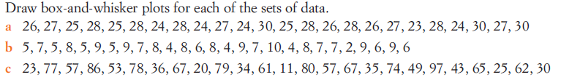
Task
Create boxplots from the data sets you used in the previous lesson.
Work out the median and inter-quartile range of each of the following sets of data showing clearly all the steps in your working.
Calculators allowed
3,9,12,15,16,18,21
152, 167, 159, 162, 140, 157, 163, 160, 155, 141, 158
1.4, 2.7, 0.2, 3.5, 4.1, 2.3, 1.9, 2.2, 1.6, 2.0, 1.6, 2.6, 2.2 ,1.8, 2.9, 3.0
5, 9, 11, 13, 16, 16, 19, 21
62,51,48,55,56,43,59,48,57,60,47,55

Slide 18
Questions

Slide 19
Notes Review
24, 7 ,30
Date
Title
Essential question
Notes complete
Notes complete with colour and diagrams
Questions completed
Contents page filed in
Formula page filled in

Slide 20
Homework
Review your notes and write a summary answering the essential question.

